Slide 1
Chapter
23
Managerial Accounting
Demo 06: High-Low Method (High-Low Co.)
Masud Jahan
Department of Science and Humanities
Military Institute of Science and Technology (MIST)

Slide 2
High-Low Company’s data for various costs in January and April of 2009 are presented below:

Slide 3
 | Level of Activity
 | January | April
No. of units produced | 6,000 Units | 9,000 Units
Materials | TK 33,000 | TK 49,500
Labor | 57,000 | 85,500
Supervision | 8,000 | 8,000
Utilities | 15,000 | 21,000
Maintenance | 5,500 | 7,000
Depreciation | 11,000 | 14,000
Rent | 7,500 | 7,500
Other | 10,000 | 14,500

Slide 4
Requirements:
1. Identify which costs are variable, fixed or mixed in nature.
2. Segregate mixed costs into variable and fixed cost element by using High-Low Method.
3. Determine the total fixed cost & total per unit variable cost.
4. Determine a linear cost formula.
5. Find out total cost at a) 0 unit, b) 500 units,
c) 4,500 units, d) 115,450 units.

Slide 5

SOLUTION
Notes:
Learning objective number 1 is to explain the purpose of adjusting entries.

Slide 6
Solution to req. 1
Variable Costs: Materials, Labor.
Fixed Costs: Supervision, Rent.
Mixed Costs: Utilities, Maintenance, Depreciation, Other.

Slide 7
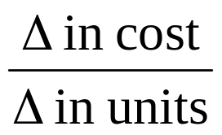
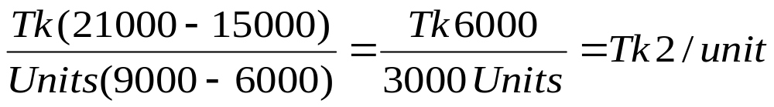
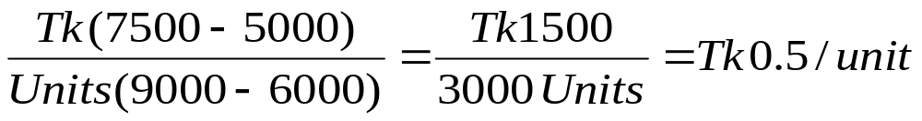
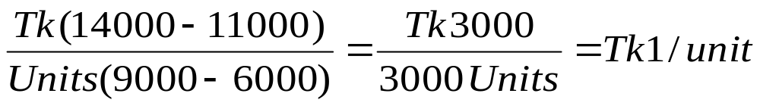
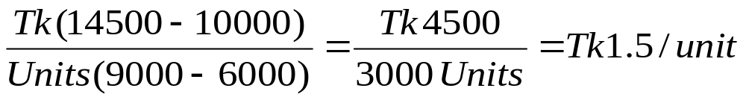
Solution to req. 2
Unit variable cost in mixed cost:
Utilities:
Maintenance:
Depreciation:
Other:

Slide 8
Solution to req. 2
Total fixed cost in mixed cost:
Utilities:
Maintenance:
Depreciation:
Other:

Slide 9
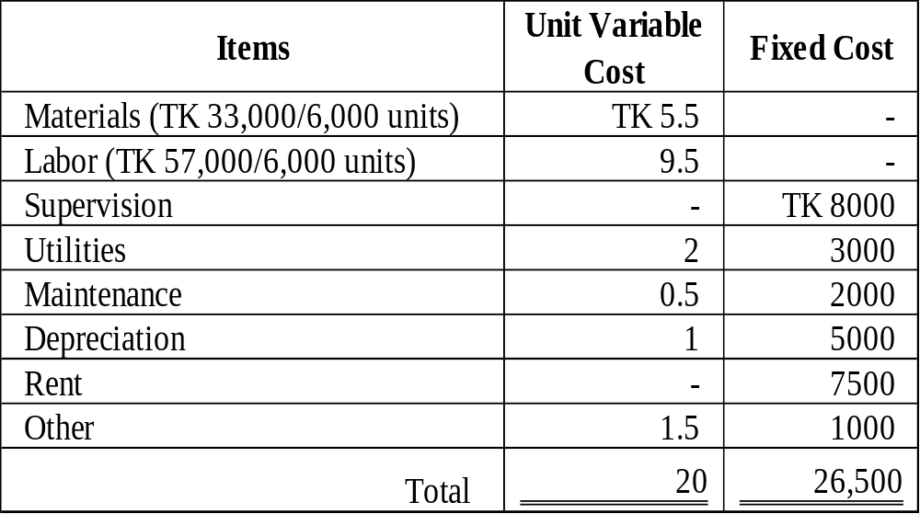
Solution to req. 3

Slide 10
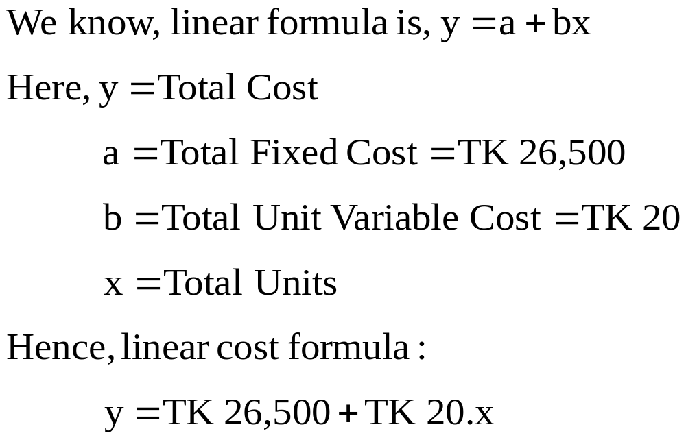
Solution to req. 4

Slide 11
Solution to req. 4

Slide 12
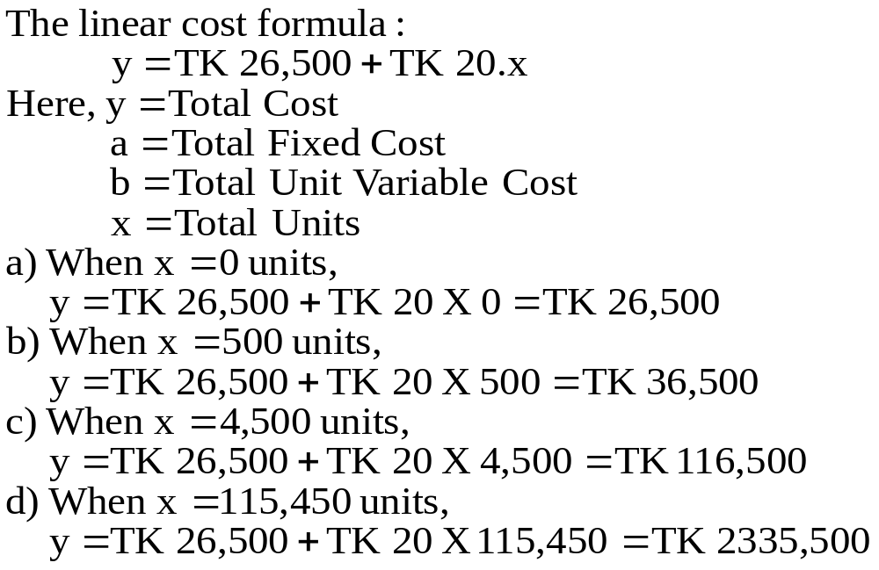
Solution to req. 5

Slide 13
End of Demo 06

